Slide 1
Making Street Hail Easier
An Analysis of Taxi Availability in Singapore

Slide 2
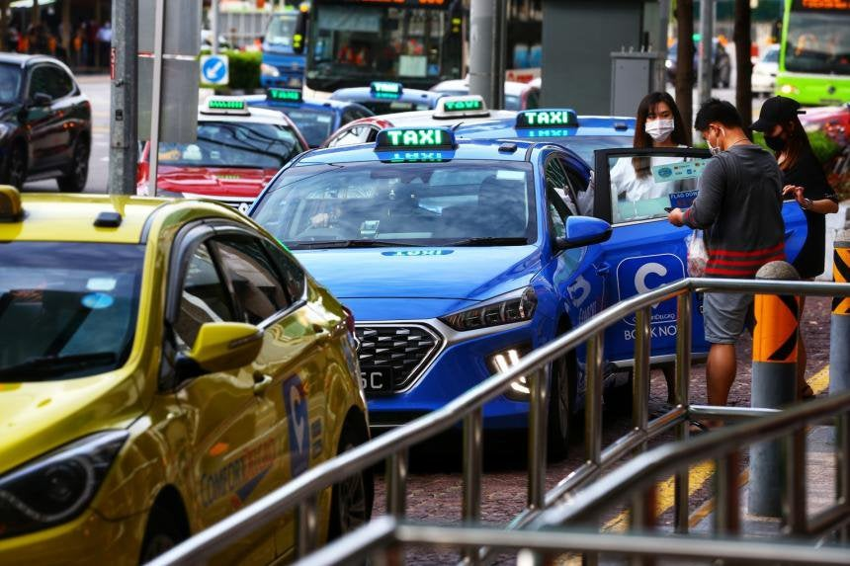
Definition
Street-hail service is a taxi service obtained through flagging from the streets or at taxi stands.
Differs from ride-hail where commuters can book for a private hire vehicle through the use of a phone app (i.e. Grab, Gojek etc)

Slide 3
3 Advantages of Street Hail
Street Hail fee structure is transparent (i.e. Flag down, per km charge) whereas PHV pricing algorithm isn’t
Ride Hail firms charges 20% commission whereas there is no commission for street hail
More Transparent Lower Fees

Slide 4

3 Advantages of Street Hail
No Mad Rush
Street Hail does not have a waiting problem
BONUS:
Avoid the problem of private hire drivers claiming that they are waiting even before they arrive at location

Slide 5
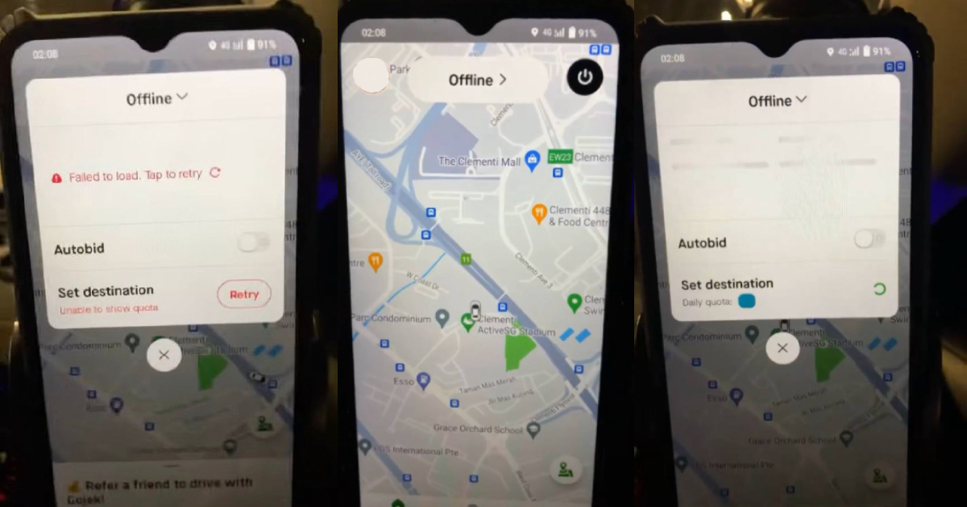
3 Advantages of Street Hail
No Service Outage
Mobile apps may malfunction
Gojek malfunctioned on a Friday Night (25th November 2022)

Slide 6
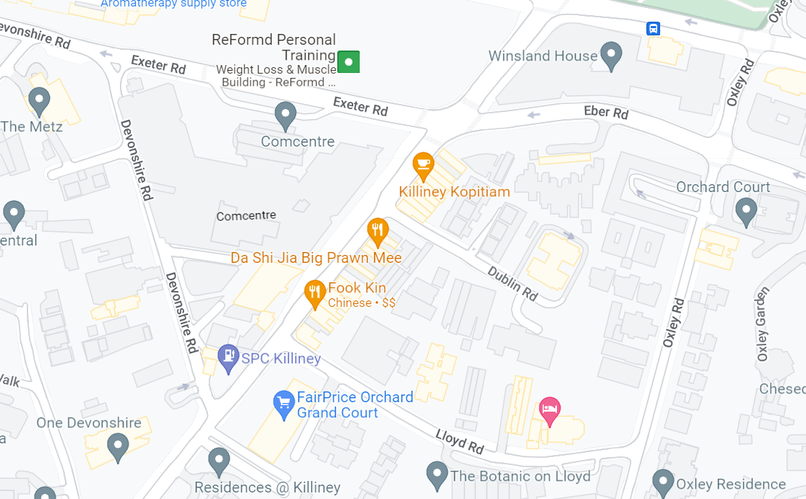
The Biggest Problem with Street Hail

Slide 7
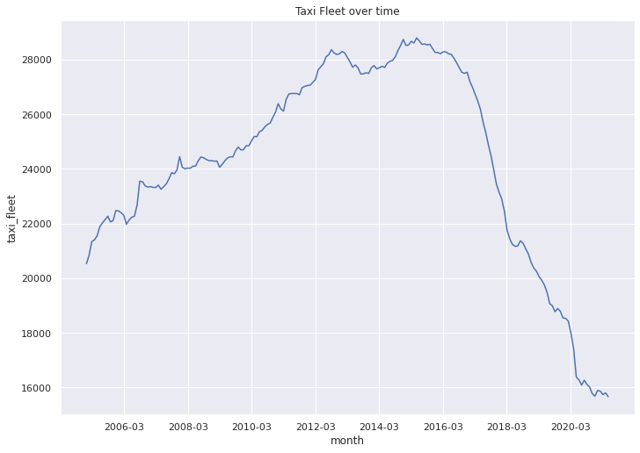
Context
Declining Fleet = Street Hail Harder to get
The taxi fleet has declined more than 40% since the peak in 2015

Slide 8
Goal
TIMING
LOCATION
Know when is the best time to get a cab, given where you are
Know where to go to increase your chances of getting a cab

Slide 9
Overview
01
02
03
04
DATASET
CURRENT LITERATURE
DATA ANALYSIS
DATA MODELLING
ACTIONABLES
05

Slide 10
DATASET

Slide 11



Street Name
Latitude, Longitude of available taxi
Raw Project Data
Traffic condition of Expressways
Temperature
Rain Fall

Slide 12
LITERATURE REVIEW

Slide 13
Current Literature
Taxi-Router SG
Current Project
Shows where all available taxis are right now
Predicts where available taxis might be 1 hour from now
Understand what affects Taxi availability
Time of the day
Weather Conditions
Traffic Conditions
Location (CBD/Non-CBD)

Slide 14
DATA ANALYSIS

Slide 15
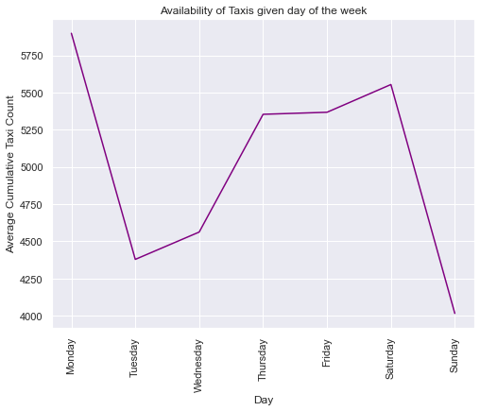
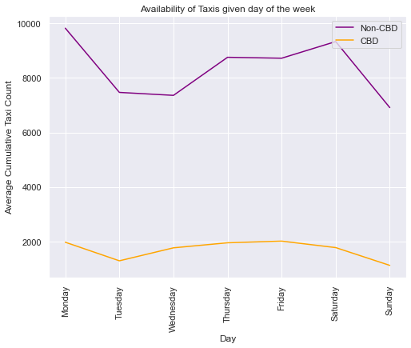
Data Analysis
01
Does day of week matter when it comes to taxi availability
Taxis are comparatively less available on Tuesday, Wednesday and Sundays
There are less Taxis in CBD and availability drops over the weekend

Slide 16
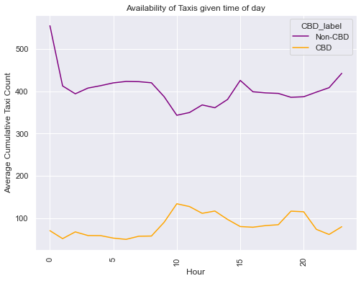
Data Analysis
02
Does time of day matter when it comes to taxi availability
Time of day seems to matter most during the morning and evening peak hours

Slide 17
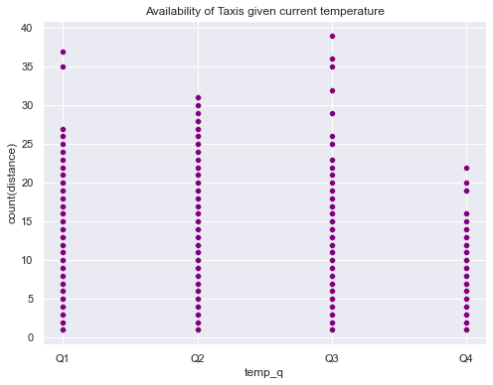
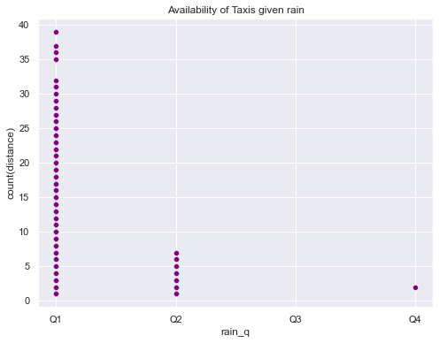
Weather Analysis
03
Does weather matter when it comes to taxi availability
Singapore is often warm and temperature does not seem to move the needle
However, the amount of rain does seem to affect the availability of taxis

Slide 18
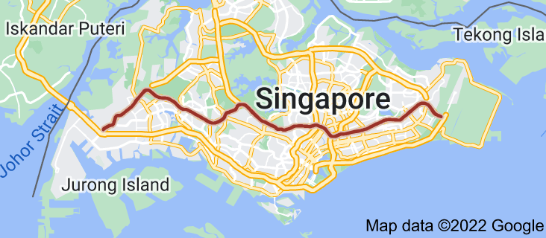
Traffic Conditions
04
Does traffic conditions matter for taxi availability
The Expressway is the main transport artery and congestion might reduce availability of Taxi

Slide 19
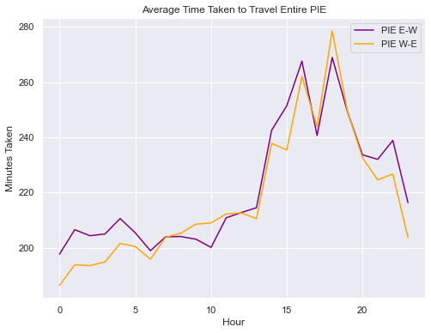
Traffic Conditions
04
Expressway tends to be congested at particular time of the day

Slide 20
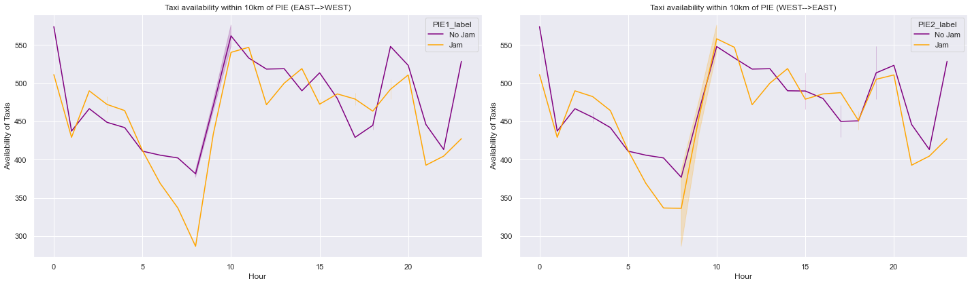
Traffic Conditions
04
Taxis are more available when there is no congestion on the expressway with the exception of peak hour in the CBD.
East to West
West to East

Slide 21
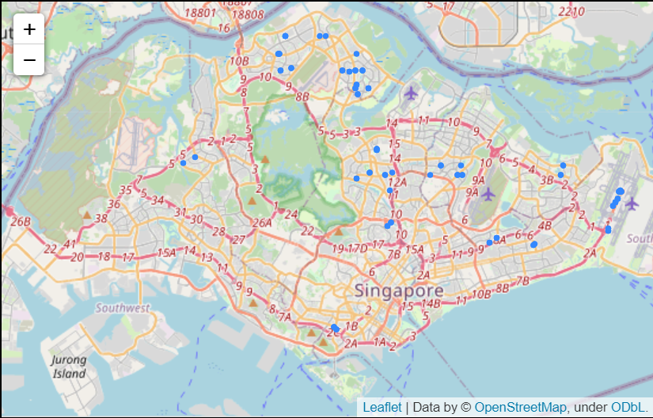
Top 50 Streets

Slide 22
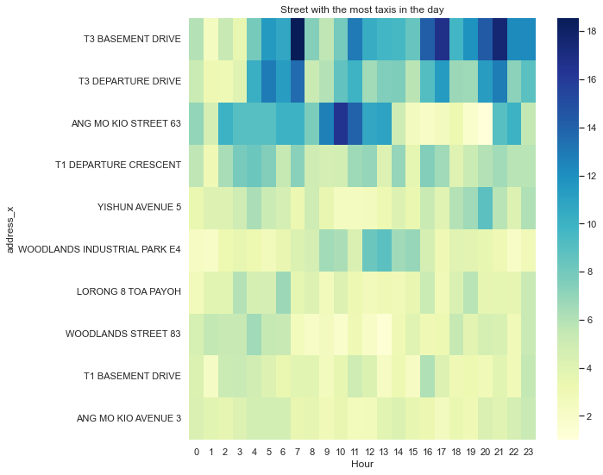
Street Analysis

Slide 23
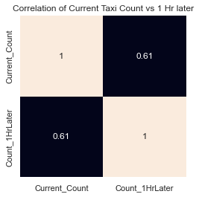
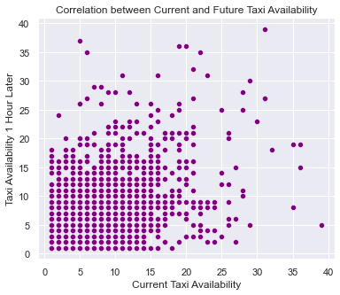
Data Analysis
05
Does having more taxis ow translate into higher taxi availability on the same street 1 hour later?

Slide 24
DATA MODELLING

Slide 25
Modelling
TYPE OF DATA
SCORE
MODEL

Slide 26
Features
ADDRESS
HOUR
TRAFFIC CONDITION
DAY OF THE WEEK
RAIN
CBD/ Non CBD

Slide 27
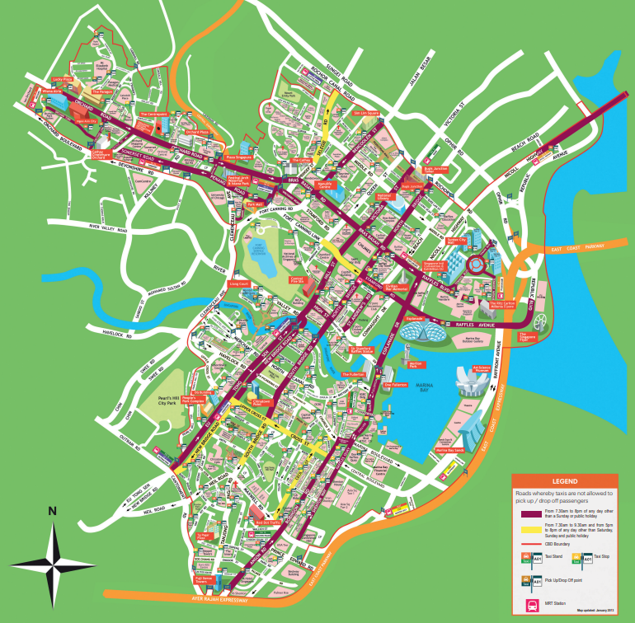
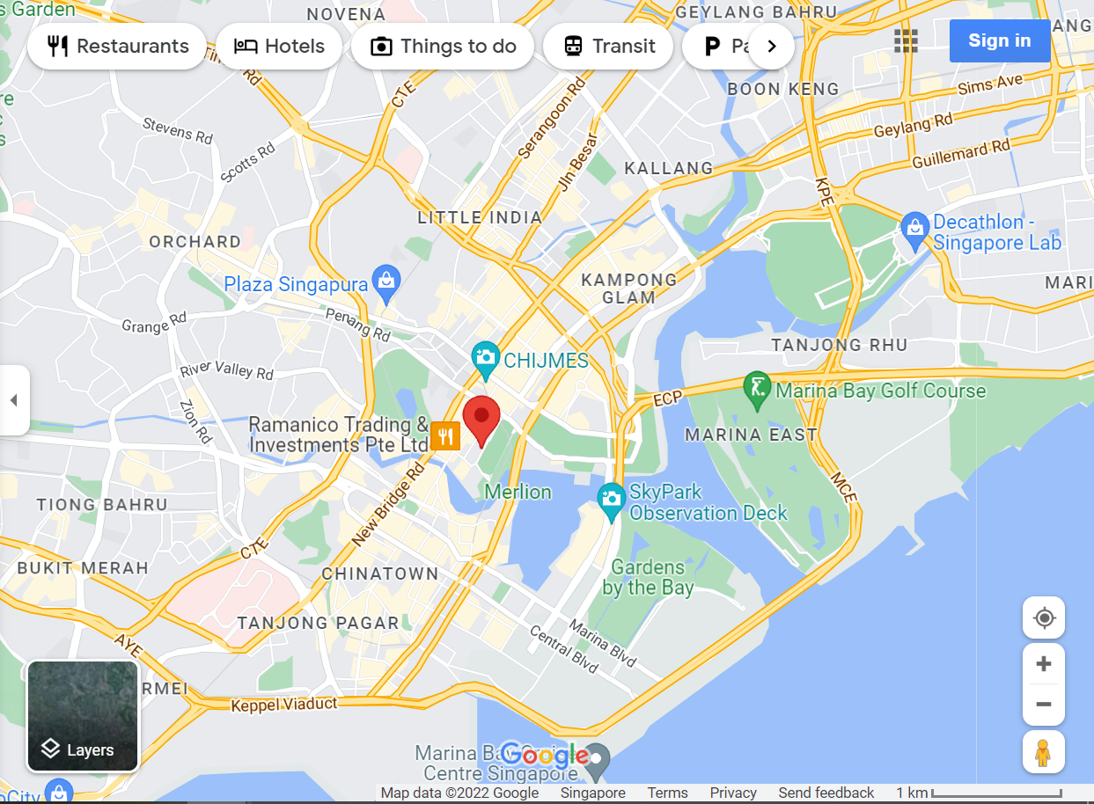
Features
Using Haversine to demarcate areas in Singapore (i.e. Central Business District)
4km
LTA Definition of CBD
Google Maps

Slide 28
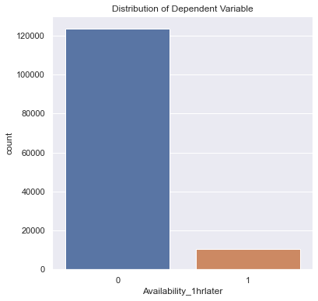
Type of Data
Availability_1hrlater
1: IF there are 2 or more taxis on that street
0: if Otherwise
Data is Imbalanced
There are less incidence of Availability

Slide 29
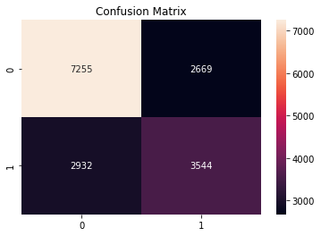
Baseline
Model:
Logistic Regression
Precision Score
Precision: 0.57

Slide 30
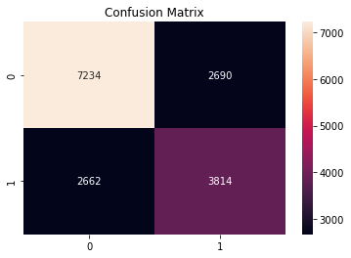
Boosting
Model:
AdaBoost
Precision Score
Precision: 0.58

Slide 31
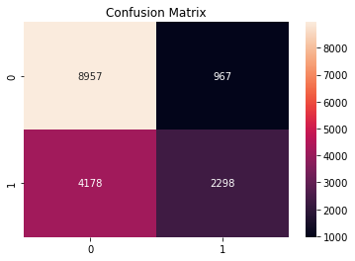
Bagging
Model:
Random Forest Classifier
Precision Score
Precision: 0.70

Slide 32
ACTIONABLES

Slide 33
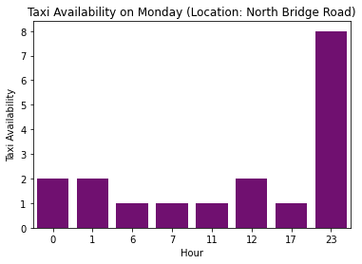
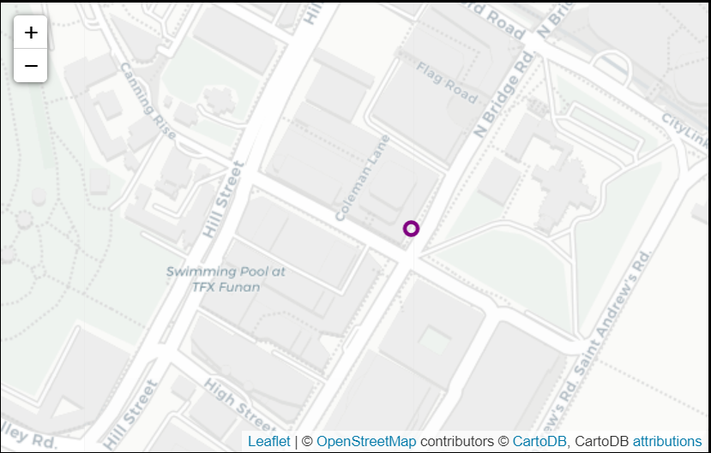
TIMING
Scenario: You are at North Bridge Road on a Monday at 5pm waiting to get home. Looking at the historical taxi availability, It is possible but may be a little difficult.

Slide 34
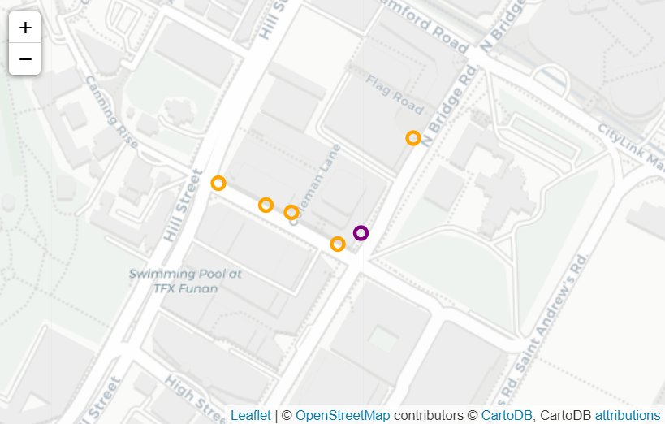
Location
Scenario: It may be difficult to get a taxi on the street you are on. If that is the case, how can the model help commuters.

Slide 35
FUTURE

Slide 36
Flight Schedules
Given that the number of taxis at Airport varies by the hour, it will be interesting to scrape the flight arrival and departure data and examine if there are any interesting insights
Fare Data
Given access to actual fare data, we will be able to add additional features like distance travelled and that may show some interesting trends where the length of the ride may differ by area or time of the day.

